Slide 1
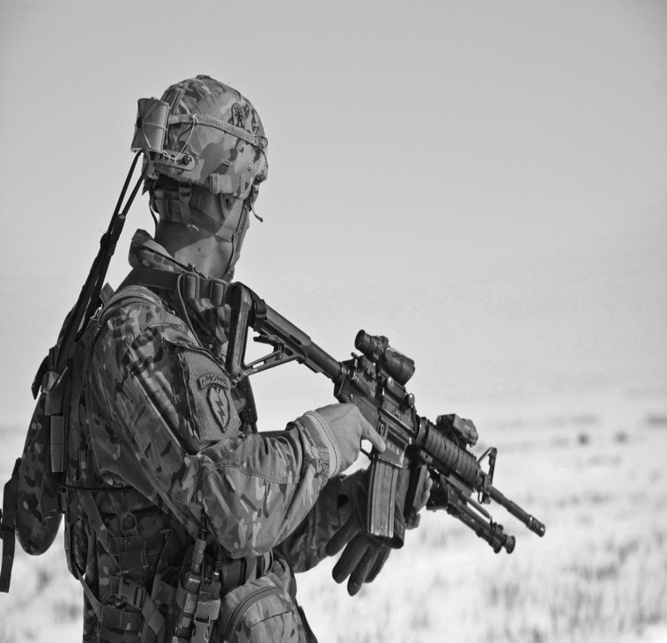
ANALYSIS OF THE G19’S MILITARY SPENDING OVER THE LAST TWO DECADES
DATS 6103 – Individual Project Junior Ovince

Slide 2
TABLE OF CONTENTS
The Datasets:
Sources
Description of the data
Some descriptive statistics
Exploratory data analysis
Comparison of military spending to GDP
Comparison of military spending overall
Identification of the fastest growing countries in military spending
The codes:
Highlighting the sections
Key functions and graphs
Conclusion
2

Slide 3
Datasets
Sources
Description
The Stockholm International Peace Research Institute (SIPRI)
known as a leader in gathering data on military expenditures
Detailed methodology on the data collection
Comprehensive datasets on military spending for all countries since 1949 (World War II)
The World Bank
A leader in gathering global economic data
Wide range of data availability in economic indicators since 1960
Rigorous data collection methodology and estimations
Time series observations of G19’s countries in terms of military spending and GDP since 1995
4 datasets: (1) GDP (constant 2010), (2) GDP per capita, (3) military spending (constant 2015), (4) military spending per capita
GDP and military spending are in millions of USD
GDP per capita and military per capita in USD
Choice of GDP and military spending in constant values for better comparison between countries and within a country over time
Each dataset has 418 observations (19 countries, 22 years)

Slide 4
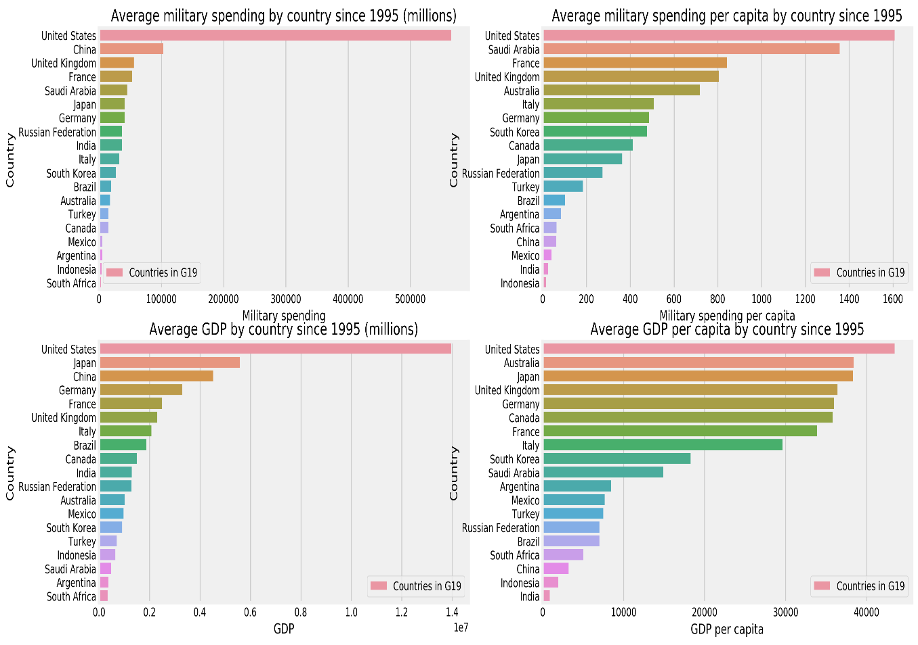
Descriptive statistics
Average military spending for G19 countries since 1995

Slide 5
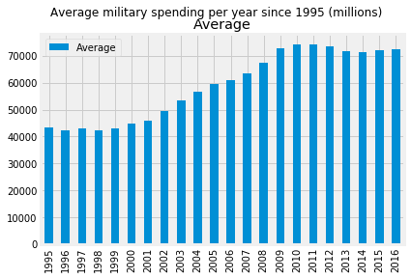
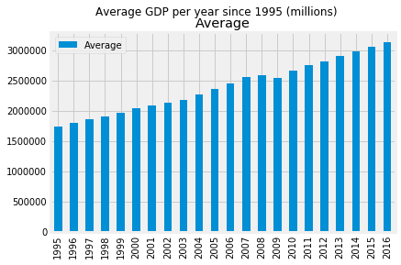
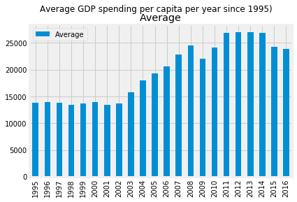
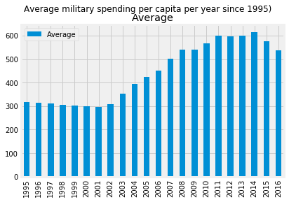
Descriptive statistics
Average military spending for G19 countries since 1995

Slide 6
Exploratory data analysis
Comparison of military spending to GDP - Methods
Key results
Military spending and GDP – fixed value
Define percentage of military spending in GDP (shares of GDP)
Select the top shares and compare the countries
Graph a scatter plot between the variables for each country
Determine the Pearson coefficient correlation for all countries
Military spending and GDP – per capita
Same methods as in fixed value to compare the variables for a country
Compare the fixed and the per capita findings
The military spending shares of GDP (fixed and per capita) is generally less than 6% for the top five countries, except Saudi Arabia (~15%)
In general, the correlation between military spending and GDP is positive and strong. However, the relation is negative for Germany and weak or Turkey and Japan.
The correlation of these variables per capita accused an even stronger relation, even for the weak and negative relations found for some countries.
These variables are perfectly related for China both in value and per capita

Slide 7
Exploratory data analysis (cont.)
Comparison of military spending overall - Methods
Key results
Define the percentage of military spending for each country per year
Graph a pie chart per year to depict trends
Define a standardized score for each country per year for a better comparison
Plot the distribution per year and depict changes over time
USA’s military spending has represented the largest part for the G19’s military spending, sometimes even more than the half (most of the countries are below zero in the standardized score distribution).
China’s military spending has evolved over time and accused a 15% percent during the last 2 years.
Some countries such as Italy and Germany have accused a reduction in the overall military spending, whereas others including Saudi Arabia and Russia have seen an increase in the overall percentage.

Slide 8
Exploratory data analysis (cont.)
Fastest growing countries - Methods
Key results
Find out the top five countries in military spending in fixed value and in percentage
Graph a stacked plot to depict the evolution for the top five countries
The top five countries represent 75% to 80% of the overall military spending for the G19’s countries
Since 2010, they have together spent more than 1billion million of US dollars in military.
China has increased its share of military spending both in value and in percentage, following by Saudi Arabia.
USA is still the leader in military spending both in value and in percentage but has seen a decrease since 2010.

Slide 9
CODES
Highlighting the sections
Key functions and graphs
6 sections
Setting up the environment and upload the datasets
Some descriptive statistics
Comparing military spending to GDP (in value)
Comparing the military spending overall
Comparing military spending to GDP (in value)
Identification of the fastest growing countries
Transforms variables and data frames
Dividing a data frame by another one
Finding the average in rows and columns
Standardizing
Finding percentage over the total
Plot graphs
Pie charts
Linear plots
Histogram and distribution
Scatter plot and linear fit regression
Built-in functions
The apply methods
Transpose, merge

Slide 10
CONclusion
Learning process
Positive
Better understanding of the third library packages such as numpy, pandas, matplotlib
Improvement in my capacity to use dataframe and do some operations
Better capacity in detecting errors or to search for solution
Better capacity to approach datasets
Use of the ipython notebook Jupyter
Room for improvement – priorities
Data visualization – better understanding of the packages plotly, seaborn, ggplot

